Slide 2
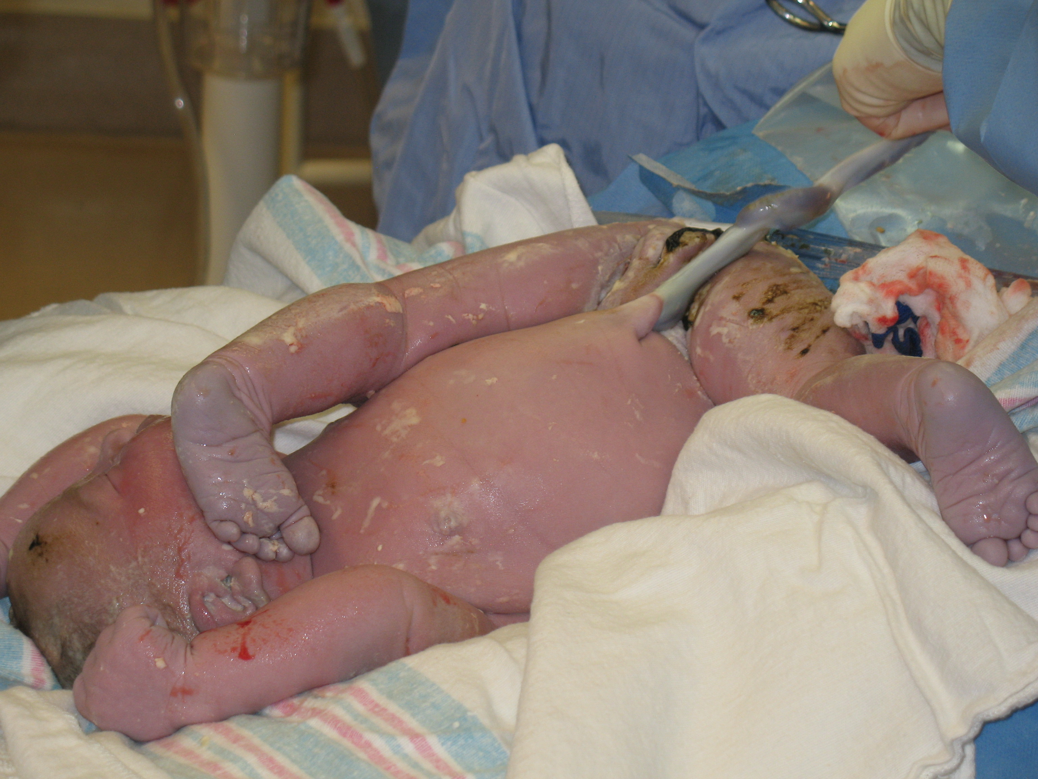

Slide 3
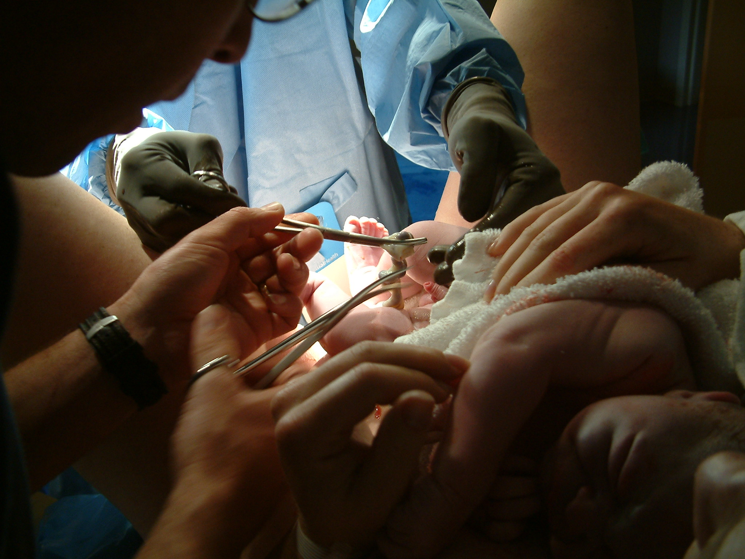

Slide 5
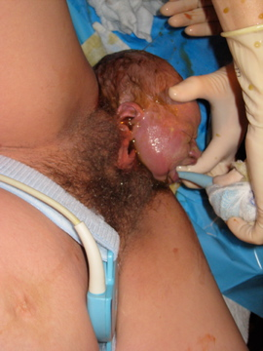

Slide 6
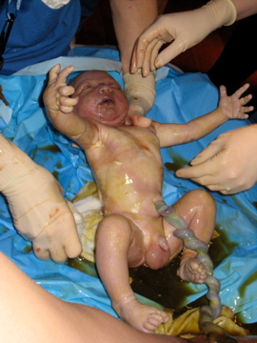

Slide 7
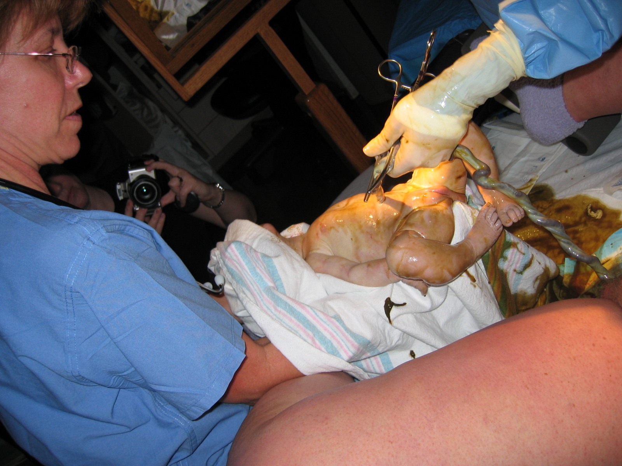

Slide 8
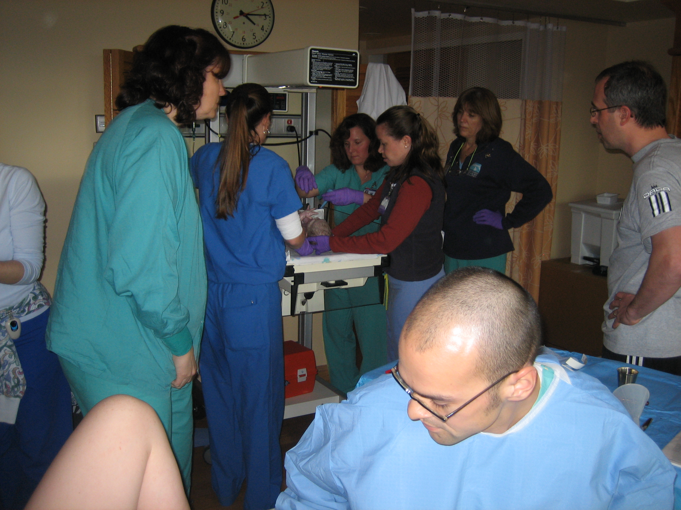

Slide 9
Airway Clearing at Warmer

Slide 10
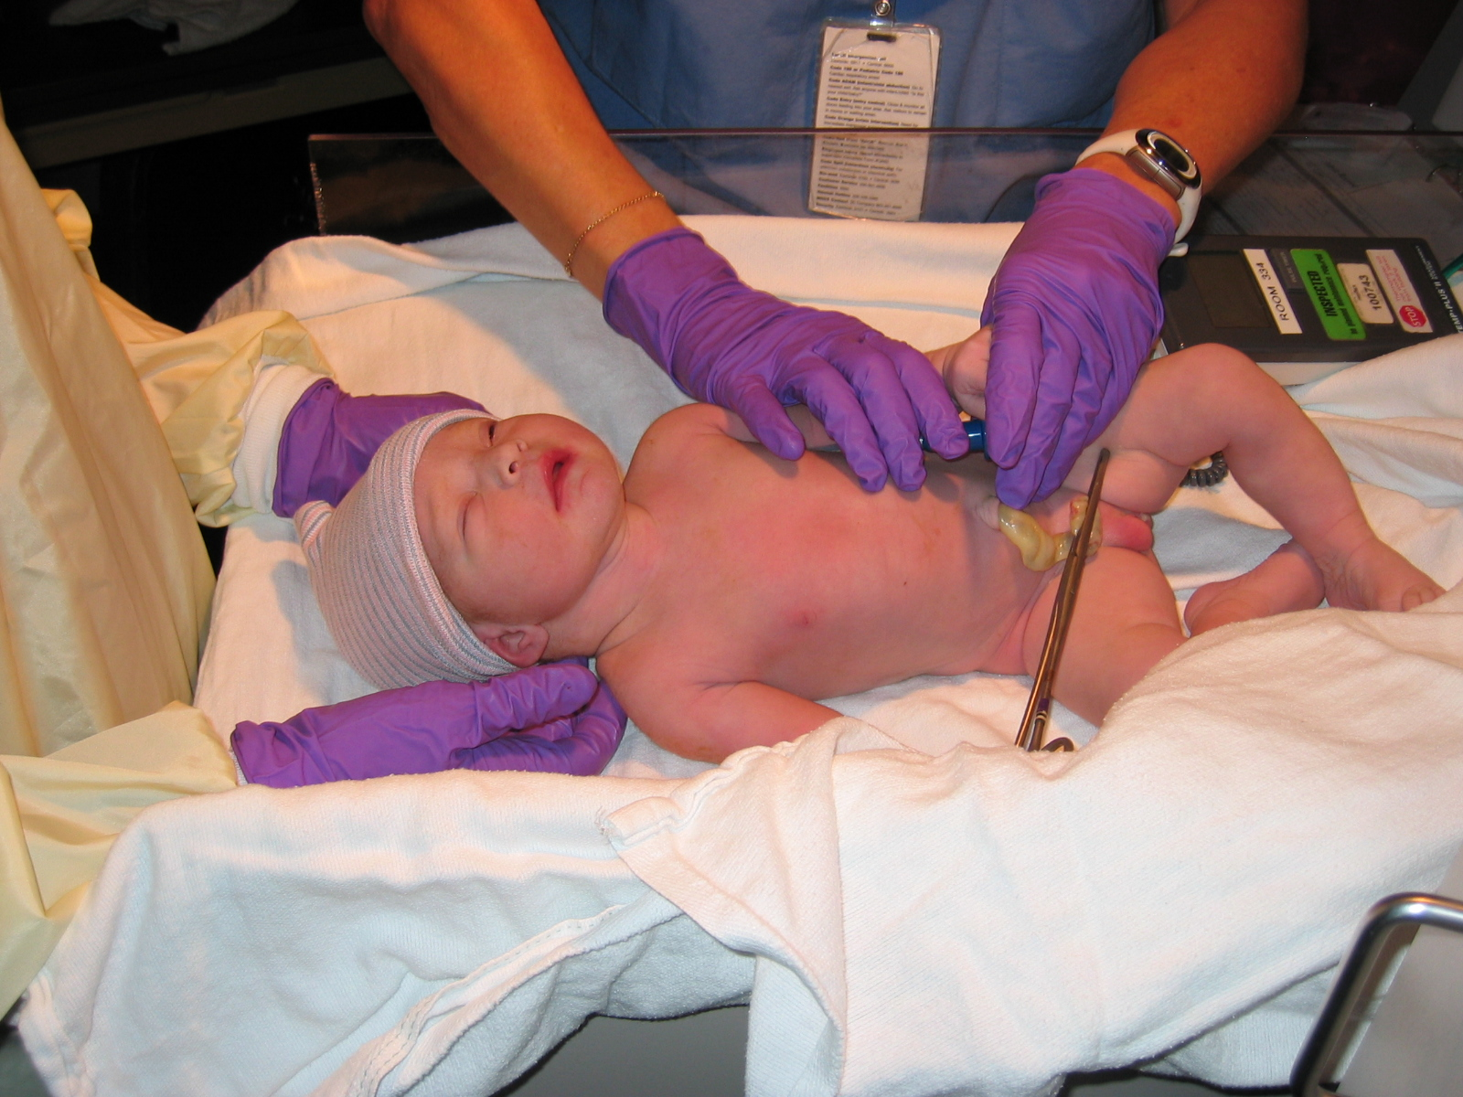

Slide 12
APGAR Scoring
Well-being assessment done at 1 and 5 (and maybe 10) minutes
 | Sign | 0 points | 1 point | 2 points
A | Activity (muscle tone) | Limp | Arms and legs flexed | Active movement
P | Pulse | Absent | Below 110 bpm | Above 100 bpm
G | Grimace (reflex irritability response to nose being suctioned) | No response | Grimace | Sneeze, cough, pulls away
A | Appearance (skin color) | Blue-gray, pale all over | Body pink, extremities blue | Pink all over
R | Respiration | Absent | Slow, irregular, weak, gasping | Good, crying
Notes:
Virginia Apgar
Assessment done usually without notice
Assesses how well baby is getting oxygen
Heart rate 110-150 bpm
Low APGAR score at 5 minutes means a 10 minute score will be done
Low APGAR scores at 10 minutes (below 5) associated with permanent brain damage
Video – water birth of Anika
Note quiet breathing, no cry, color change, vernix

Slide 15
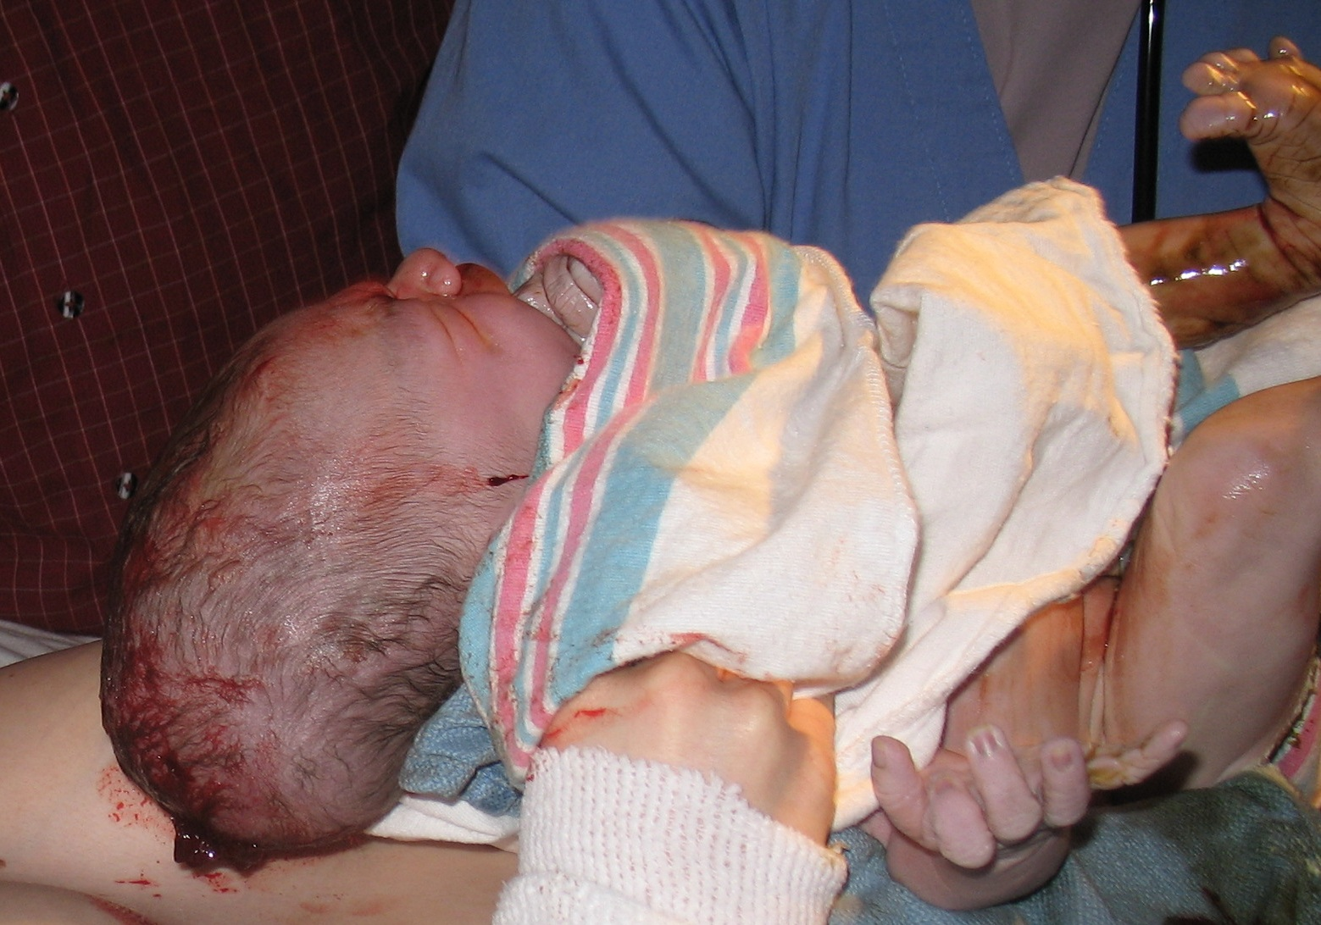

Slide 16
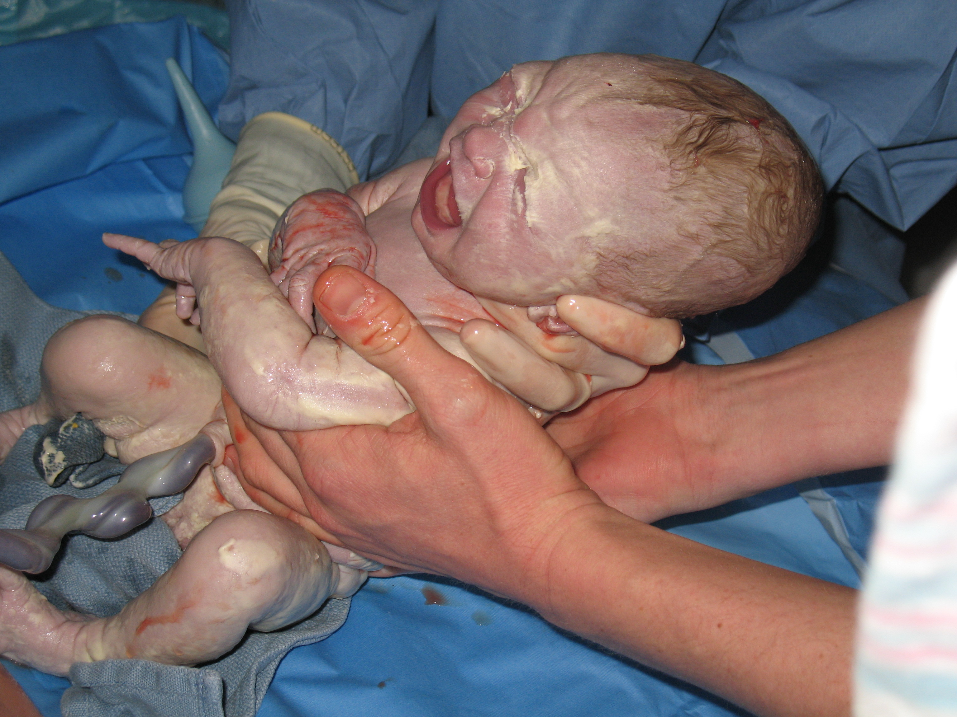

Slide 17
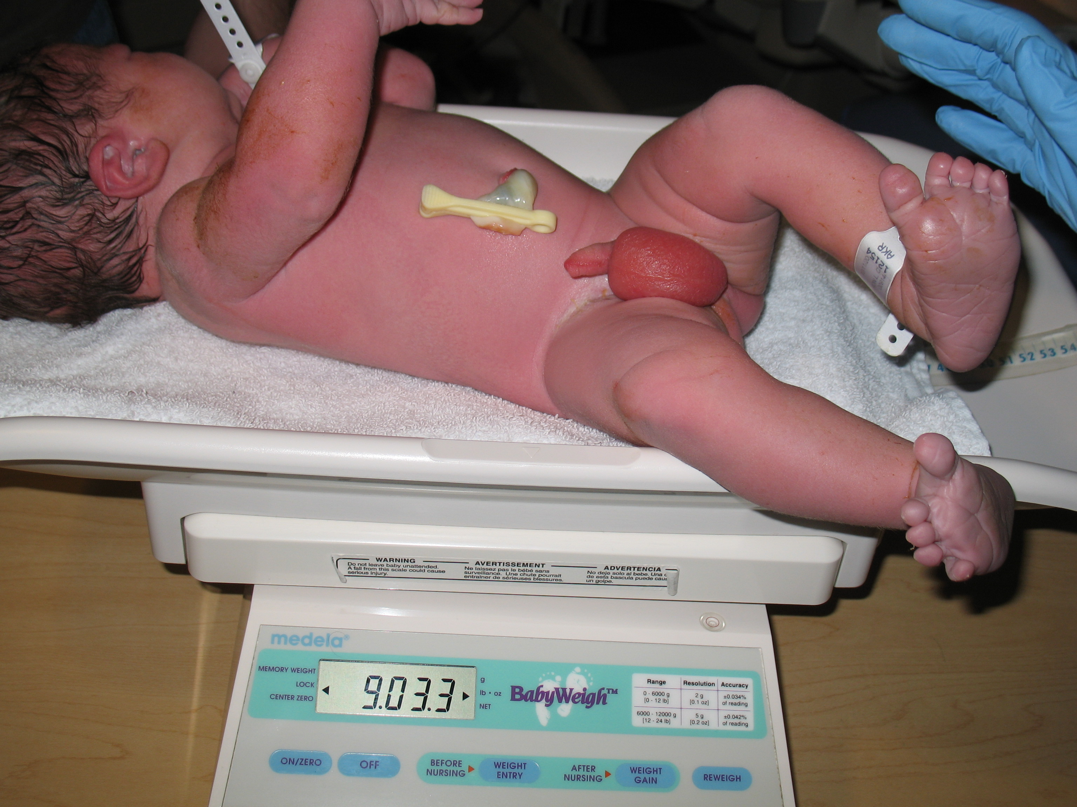

Slide 23
Oxygen Assessment

Slide 24
Cord Cutting and Clamping

Slide 29
Routine Newborn Procedures
Weight & Length
ID tag
Eye ointment
Vitamin K shot
Bath
Hepatitis B shot

Slide 31
Possible Problems
Breathing – nasal flaring, grunting, retraction of ribs, blue lips, apnea
Temperature – cold to touch, limp, blue hands and feet
Hypoglycemia – apathy, abnormal cry, hypothermia, irregular resp, convulsions (severe)
Infection (sepsis) – lethargic, irritable, tremors, respiratory problems, vomiting, low temp
Notes:
Breathing (normal 30-60 bpm) probs – cyanosis at room air
Tachypnea – RR > 60 bpm
Apnea – periods of not breathing > 20 sec with cyanosis
Temp 96-98 axillary
If cold, heat pad or lamp, water bottle
Hypoglycemia:
Fetus receives constant glucose supply from mom via the placenta
Glycogen store is adequate for first 1-2 hours after birth
Blood glucose level falls in normal newborn after birth, usually reaching lowest level in 1-2 hours, remains low until feedings begin, then begins to rise
Blood glucose level checked with heel stick/Dextro stix
Evidence of maternal problem
Newborn assesses as height risk (high or low birth weight, prematurity)
Mild – apathy, abnormal cry, hypothermia, irregular respirations, refusal to feed
Moderate - apnea, cyanosis, marked tremors, limpness
Severe - convulsions

